Slide 1
Introduction to Operating Systems
Week 1

Slide 2
What is an Operating System?
A huge resource manager
  Sits between the hardware and the programs you run
  Decides which program gets the processor, memory, storage, and network, and when
  Without one, every app would need to know how to talk to every piece of hardware
Notes:
Reference: IBM, What is an operating system?: https://www.ibm.com/think/topics/operating-systems

Slide 3
The Early Years: 1940s to 1960s
1940s
  Early computers did not include operating systems
  People set up each job by hand with switches and plugboards
1950s
  Executed one job at a time (single-stream batch processing)
  Programs and data submitted one after another on punched cards or tape
1960s
  Multiprogramming: process multiple jobs at once
  One job uses the processor while others use printers or tape drives
  Timesharing lets many interactive users share one computer
  1969: Ken Thompson and Dennis Ritchie start Unix at Bell Labs
Notes:
Linux, macOS, Android, and iOS all trace ideas back to Unix.
Reference: Dennis Ritchie, The Evolution of the Unix Time-sharing System: https://www.nokia.com/bell-labs/about/dennis-m-ritchie/hist.html

Slide 4
The 1970s and 1980s
1970s
  Supported batch processing, timesharing, and real-time applications
  1973: Unix is rewritten in C, making it much easier to move to new hardware
  DARPA, part of the Department of Defense, funds TCP/IP, the base of the Internet
1980s
  Decade of personal computers and workstations
  Computing moves out of the computer room into offices and homes
  GUIs go mainstream: Apple Macintosh (1984) and Microsoft Windows (1985)
  1983: Richard Stallman starts the GNU Project to build a free Unix-like system

Slide 5
The 1990s
Networking and Internet support became standard
Microsoft became dominant on desktops, especially after Windows 95
1991: Linus Torvalds releases the Linux kernel
  Combined with GNU tools, it becomes a complete free operating system
Building software out of reusable pieces (object-oriented design) became popular
Most commercial software was sold without the source code (closed source)
Free and open-source software, where anyone can read and change the code, became increasingly common
Notes:
Why some people say GNU/Linux: https://www.gnu.org/gnu/linux-and-gnu.html

Slide 6
The 2000s and 2010s
2000s
  Mac OS X (2001) moves the Mac onto a Unix-based system
  Linux becomes the most common operating system for web servers
  Virtualization: one physical server runs many virtual machines (Week 14)
  Smartphones: iPhone (2007) and Android (2008), built on the Linux kernel
2010s
  Cloud computing: rent servers by the hour instead of buying them
  Containers, such as Docker, package an app with everything it needs to run
  Since 2017, all of the 500 fastest supercomputers run Linux
Notes:
TOP500 list statistics (choose Operating System Family): https://www.top500.org/statistics/list/

Slide 7
The 2020s
ARM processors move from phones into laptops and servers
  Apple Silicon Macs, Windows on ARM
Security moves into the hardware
  Windows 11 requires TPM 2.0 and Secure Boot (Week 12)
Parts of the Linux kernel can now be written in Rust
  A language designed to prevent many common security bugs
AI assistants built into operating systems
  Copilot in Windows, Apple Intelligence on Apple devices
Notes:
Linux kernel documentation, Rust: https://docs.kernel.org/rust/index.html

Slide 8
Software
Low-level language
  Close to what the hardware understands: machine code (1s and 0s) and assembly
  Fast, but hard for people to read and write
High-level language
  Reads more like English: Python, C, Rust
  A compiler or interpreter translates it for the hardware
Application software vs System software
  These programs perform computations, control, manage, and carry out other important tasks

Slide 9
System Software
Programs that control the hardware and keep the computer running, so your apps can run
Three types of users: system programmers, application programmers, and end-users
Examples:
  The operating system itself
  Device drivers: let the OS talk to a specific printer, graphics card, or Wi-Fi chip
  Firmware, such as UEFI: starts the computer before the OS loads
  Utilities: backup tools, disk checkers, package managers (apt, dnf)
Historical note: BIOS was the PC startup firmware for about 40 years. UEFI has replaced it
  Still worth knowing because people and settings menus still call UEFI "the BIOS", and older machines still use it
Notes:
UEFI Forum FAQs: https://uefi.org/faq

Slide 10
Application Software
Programs people use to get things done, made to solve specific problems
Installed apps run directly on the operating system
  Web browsers: Chrome, Firefox, Safari, Edge
  Games, such as those from Steam or a console store
  Phone apps: Spotify, Discord, your bank's app
Web apps run inside the browser instead of being installed
  Email: Gmail, Outlook on the web
  Office tools: Google Docs, Microsoft 365 online
  If you are a student, learning system (LMS), examples include Brightspace, Canvas and Blackboard
The OS runs the browser, and the browser runs the web app
Notes:
MDN, How the web works: https://developer.mozilla.org/en-US/docs/Learn_web_development/Getting_started/Web_standards/How_the_web_works

Slide 11
Kernel
The core of the OS: loads first and stays in memory the whole time
Main parts:
  Processor scheduler: decides which program runs next
  Memory manager: hands out memory and keeps programs apart
  I/O manager: handles input and output devices
  Interprocess communication (IPC) manager: lets programs send messages to each other
  File system manager: keeps track of files and folders
Notes:
Red Hat, What is the Linux kernel?: https://www.redhat.com/en/topics/linux/what-is-the-linux-kernel

Slide 12
Kernel Designs
Monolithic kernel: everything runs together in one big program
  Linux is monolithic, but can load modules, such as a new driver, while running
Microkernel: only the bare minimum runs in the kernel
  Everything else runs as separate programs
  More reliable if one piece crashes, but often slower
Hybrid kernel: a mix of both
  Windows and macOS use hybrid designs

Slide 13
Operating System Goals in General
Efficiency: getting the most work out of the hardware
Robustness: not crashing when something goes wrong
Scalability: still working well with more processors, memory, or users
Extensibility: being able to add new features later
Portability: running on different kinds of hardware
Security: keeping attackers out
Protection: keeping users and programs from damaging each other
Interactivity: responding quickly to the user
Usability: being easy for people to use

Slide 14
User Goals
Convenient to use
Easy to learn
Reliable
Safe
Fast

Slide 15
System Goals
Easy to design
Easy to implement and maintain
Flexible
Reliable
Error-free
Efficient

Slide 16
User Interfaces
Three levels of interface:
  Graphical user interface (GUI)
    Windows, icons, menus, and a pointer, plus touch screens and voice assistants
    On Linux the GUI can be swapped out, such as GNOME or KDE Plasma
  Command level (the shell)
    Command-line interpreter: you type a command, and it runs it
    Linux shells: bash and zsh. Windows: PowerShell
    Most servers have no GUI, so IT jobs still use the shell every day
  System calls invoked from user programs
    How programs ask the kernel for help (next slide)

Slide 17
System Calls
How a program asks the kernel to do something for it
  Open a file, send data over the network, start another program
Think of a restaurant
  You (the program) can't walk into the kitchen (the hardware)
  You give your order to the server (a system call)
  The kitchen staff (the kernel) does the work and brings back the result
System calls are part of the Application Programming Interface (API)

Slide 18
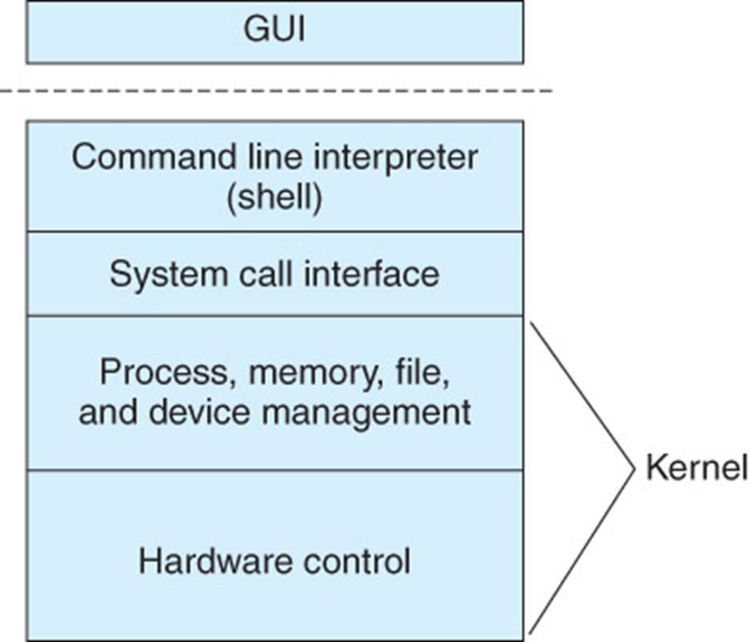
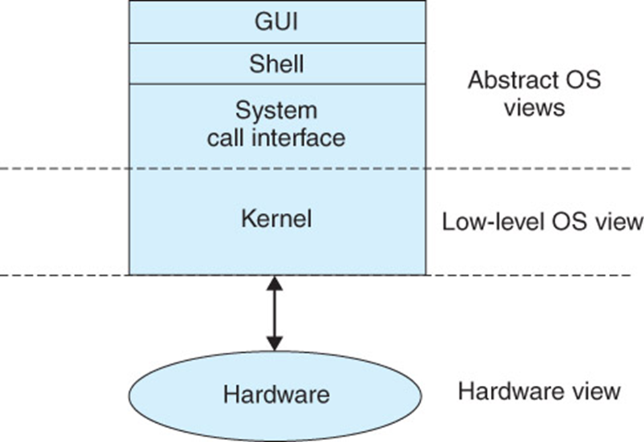
Structure of an OS
Basic Structure of an OS
Abstract View of an OS

Slide 19
Services Provided by the OS
Process control, execution, scheduling, etc.
Communication between processes
File manipulation
Device manipulation
Information maintenance, such as the time, date, and system logs
Memory management
Security and protection, such as user accounts and permissions

Slide 20
Categories of Operating Systems
Batch systems: jobs submitted in sequence for processing
  Still used for big jobs no one waits on: overnight payroll, scheduled cron jobs on Linux
Interactive systems: support computing for online users
  The most common type is time-sharing (multi-user). Your laptop and phone are interactive
Real-time systems: very tight timing constraints
  Hard real-time: missing a deadline is a failure, such as airbags or anti-lock brakes
  Soft real-time: missing a deadline is annoying, such as a video call stuttering
Hybrid systems: support batch and interactive computing
Notes:
FreeRTOS, RTOS fundamentals: https://www.freertos.org/Documentation/01-FreeRTOS-quick-start/01-Beginners-guide/01-RTOS-fundamentals

Slide 21
Operating System Families
Windows
Unix and Unix-like
  Linux, including Android and ChromeOS
  BSD, such as FreeBSD, found in network equipment and game consoles
  macOS and iOS, built on Apple's Darwin, which has BSD roots. macOS is certified Unix
Mainframe systems, such as IBM z/OS, which still run many banks, airlines, and government systems

Slide 22
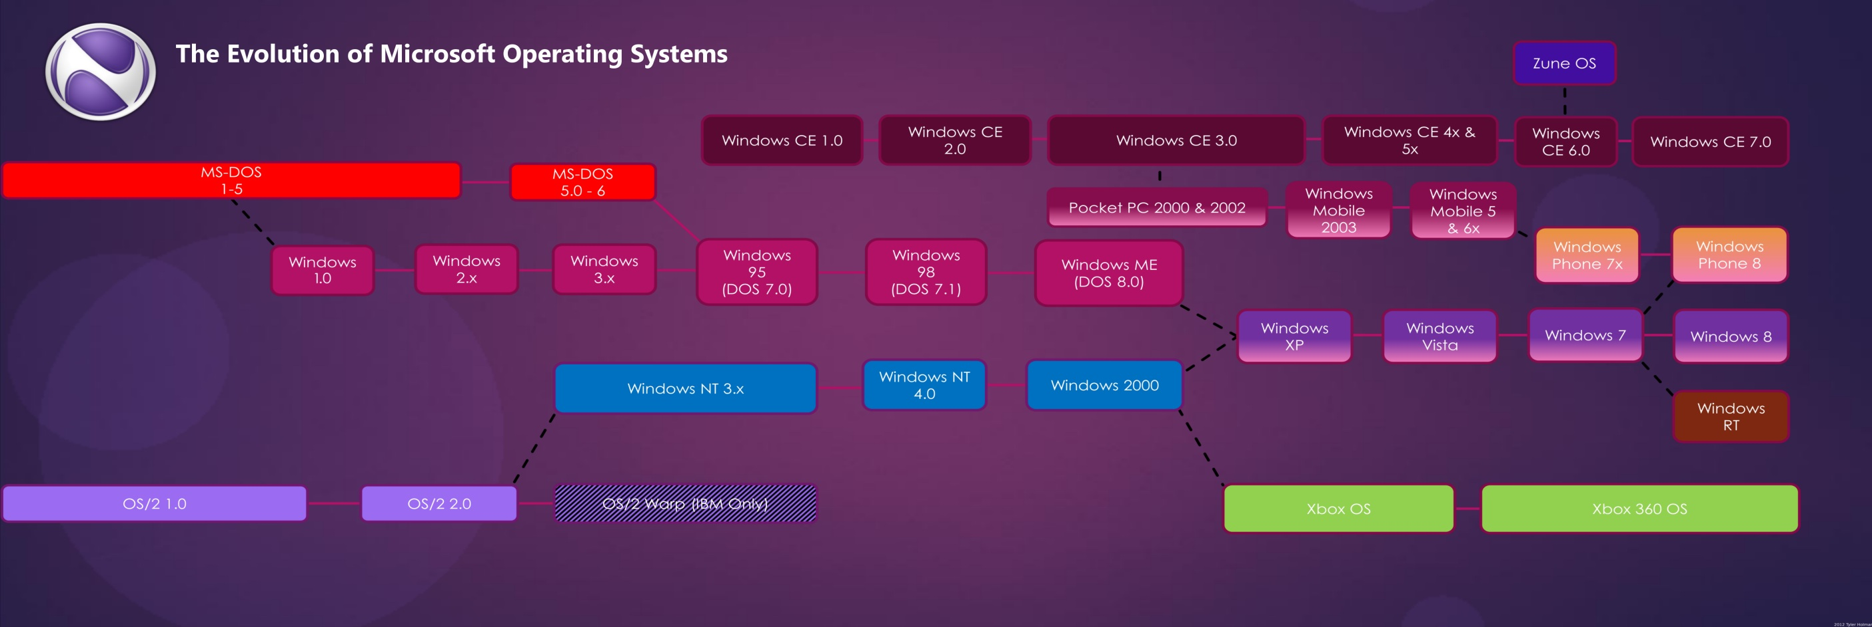
Windows
Image: Microsoft family tree, Neowin (archived, versions up to 2012)
Current list: Wikipedia, List of Microsoft Windows versions

Slide 23
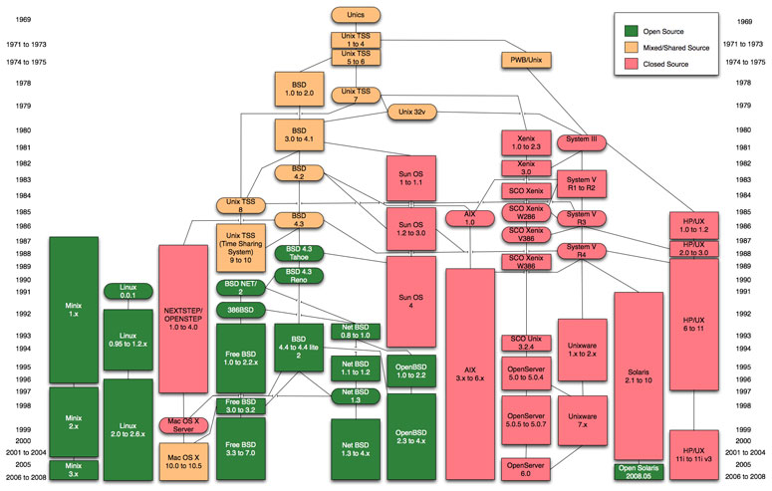
Unix and Unix-Like
Simplified tree: Wikipedia, Unix history
Full chart: levenez.com/unix
Unix family tree (2009)

Slide 24
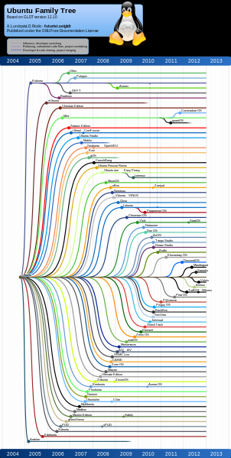
Linux Distribution Family Trees
A distribution (distro) is the Linux kernel bundled with tools, a GUI, and apps
Many distros are built on other distros
  Linux Mint is built on Ubuntu, which is built on Debian
Image: Ubuntu family tree (2012 snapshot)
Up to date: Linux Distributions Timeline

Slide 25
Operating Systems Today
Desktop and laptop: Windows 11, macOS, Linux (Ubuntu, Fedora, Linux Mint), ChromeOS
Servers and cloud: Linux (RHEL, Ubuntu Server, Debian), Windows Server, FreeBSD, IBM z/OS
Mobile: Android (built on Linux), iOS and iPadOS
TVs and cars: Google TV, Tizen, webOS, Android Automotive, Automotive Grade Linux
Small devices: FreeRTOS, Zephyr
Every version eventually stops getting security updates (end of life)
  Microsoft ended support for Windows 10 in October 2025
  Look up any version at endoflife.date
Notes:
Microsoft end of support: https://www.microsoft.com/en-us/windows/end-of-support
endoflife.date: https://endoflife.date/
StatCounter OS market share: https://gs.statcounter.com/os-market-share

Slide 26
Historical and Legacy Systems
Historical note: major systems that few or no new computers use today
  Older Windows: 98, Me, CE, 2000, XP, Vista, 7, and 8
  Solaris (Sun, now Oracle), OSF/1 (DEC), IRIX (Silicon Graphics), OS/2 (IBM)
  VMS (DEC/Compaq/HP), still sold today as OpenVMS
  OS/390 (IBM), now called z/OS
Still important because replacing old systems is expensive or risky, so companies keep them running for years
  Example: a factory machine or medical device that only works with Windows XP
  IT workers need to recognize these systems, and know the risk of running an OS with no security updates

Slide 27
Current Trends
Middleware: connects programs across a network and different kinds of machines
Web and cloud services: ready-to-use pieces, such as maps, payments, or logins
Cloud computing: the OS runs on rented servers in someone else's data center
Virtual machines (VMs) and containers (Week 14)
Embedded operating systems and the Internet of Things (IoT)
Mobile
Distributed systems (Week 14)
Security built into hardware, and memory-safe languages such as Rust
AI features built into the operating system

Slide 28
Mobile Operating Systems
Control smartphones, tablets, and smartwatches
Historical note: early mobile operating systems were much smaller and simpler than desktop ones
  Today Android and iOS are full operating systems, built on the same foundations as Linux and macOS
  Still worth knowing because phones now need the same security updates as laptops
Mobile operating systems focus on:
  Battery life
  Wireless: cellular, Wi-Fi, and Bluetooth
  Touch screens
  Keeping apps separated for security (sandboxing)
Notes:
Android Open Source Project, AOSP overview: https://source.android.com/docs/setup/about
Android kernel overview: https://source.android.com/docs/core/architecture/kernel

Slide 29
Embedded Operating Systems
A computer built inside another device to do a specific job
Small controllers (microcontrollers)
  No operating system, or a small real-time OS such as FreeRTOS or Zephyr
  Microwaves, airbag and brake controllers, fitness trackers, smart bulbs
  Very compact, efficient, and specialized
Powerful devices run a full operating system, usually based on Linux
  Smart TVs: Google TV, Tizen, webOS. They install apps like a phone
  Car dashboards: Android Automotive, Automotive Grade Linux, QNX
  Routers, smart speakers, and game consoles
A modern car has both: a full OS for the screen and maps, and dozens of real-time controllers for brakes, airbags, and the engine
Connected cars can be hacked remotely, like the 2015 Jeep hack (Week 13)
Notes:
The Yocto Project (Linux for embedded devices): https://www.yoctoproject.org/
Android TV for developers: https://developer.android.com/tv
LG webOS TV for developers: https://webostv.developer.lge.com/
Android Automotive: https://source.android.com/docs/automotive
Automotive Grade Linux: https://www.automotivelinux.org/

Slide 30
Internet of Things (IoT)
Everyday devices connected to the Internet
  Smart doorbells, thermostats, speakers, plugs, cameras, and appliances
Most are embedded systems: anything from a tiny real-time OS to full Linux
Challenges
  Security: weak default passwords, and some never get updates
  Hacking: in 2016, the Mirai malware took over home routers and cameras that still had default passwords (Week 13)
  Short support life: a company can stop updates, or shut down the app the device needs
  Brands that don't work together. Matter (2022) is one example of a standard so they can
Notes:
IBM, What is the Internet of Things?: https://www.ibm.com/think/topics/internet-of-things
NIST Cybersecurity for IoT Program: https://www.nist.gov/itl/applied-cybersecurity/nist-cybersecurity-iot-program
Matter: https://csa-iot.org/all-solutions/matter/
Smart Home Project: https://aholdengouveia.name/SmartHome/smarthomewelcome.html

Slide 31
System Implementation
Traditionally written in assembly language, operating systems can now be written in higher-level languages
  Unix was one of the first, rewritten in C in 1973
  Linux, Windows, and macOS are still mostly C and C++
Code written in a high-level language can be written faster, is more compact, and is easier to understand and debug
Far easier to port (move to other hardware): Linux runs on everything from a Raspberry Pi to a supercomputer
New trend: memory-safe languages such as Rust stop many security bugs before they happen
  Since 2022, parts of the Linux kernel can be written in Rust
Notes:
Linux kernel documentation, Rust: https://docs.kernel.org/rust/index.html

